Slide 1

Analysis of Number of Child Births and Infant Deaths in India
- Guided by Arnab Bhattacharya

Slide 2
Contributors
Group Number: 5
Name | Roll No. (Email-ID)
Lavlesh Mishra | 19111048 (lavleshm@iitk.ac.in)
Kuldeep Kumar Solanki | 19111045 (kuldeeps@iitk.ac.in)
Jaydeep Meda | 19111039 (jaydeepm@iitk.ac.in)
Aditya Jain | 20111418 (kun20@iitk.ac.in)
Rohit Singh | 20111004 (adityaj20@iitk.ac.in)

Slide 3
Broad Aims of the Project
We aim to create a model which uses HMIS(Health Management Information System) and CENSUS data to predict the following for a district in a particular year.
Number of births
Number of still births
Number of infant deaths

Slide 4
Datasets Used
Performance of Key Health Management Indicators for each district in India (HMIS)
Released by Ministry of Health under National Health Mission flagship program
Seeks to provide effective healthcare to the rural population throughout the country
Includes the key indicators which affects health of mother and child during pregnancy and at the time of delivery
Data for financial years 2008 to 2019
Census Data 2001 and 2011
Available at district level for total population, age, disability, education, migration, religion, and various other features
Generated projections of census data for the years 2008 to 2018

Slide 5
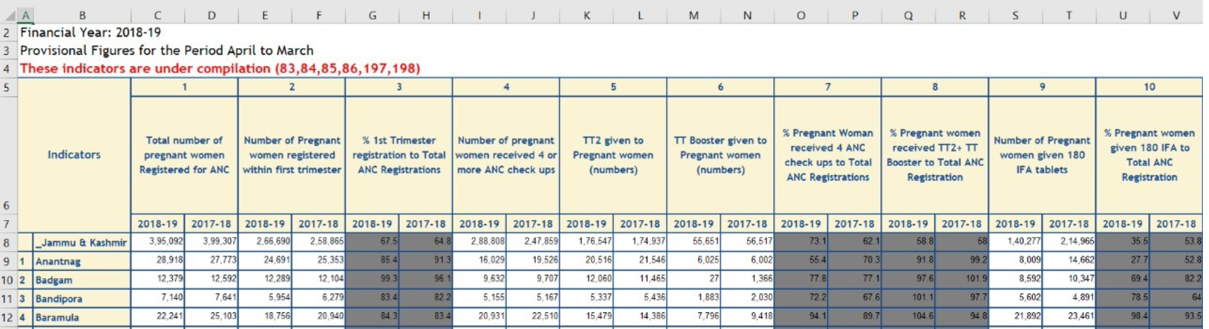
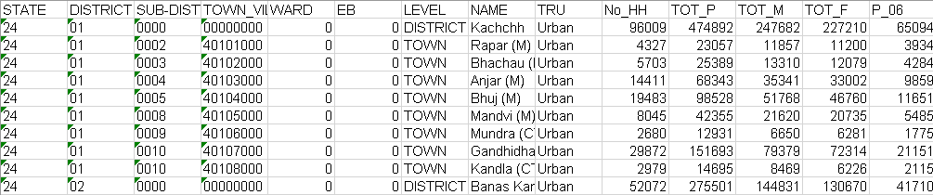
Unstructured Data
HMIS Data:
Data we found was in unstructured excel files
Census Data:
Census data is semi-structured
We converted them into structured comma separated files (csv).

Slide 6
Data Preprocessing - HMIS
Characteristics
385 csv files for 28 States and 7 Union Territories
Data set has 163 attributes
Each files stores the data for two years and has 325 columns
Cleaning
Removed attributes having missing values
Removed redundant attributes

Slide 7
Data Preprocessing - CENSUS
Characteristics
Available district wise data for year 2001 and 2011
Data set has 64 and 94 attributes for the year 2001 and 2011 respectively
Inconsistency in data
The attribute 'All ages’ has data for the people whose age are not known
‘Literate’ attribute includes figures for ‘literates without educational level’ and ‘educational levels not classifiable’
District IDs are outdated. Since 2011 many districts are newly created which led to the change of district IDs
Ever married women includes currently married, widowed, divorced and separated
There are missing values in the dataset, represented by NaN

Slide 8
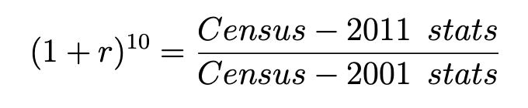
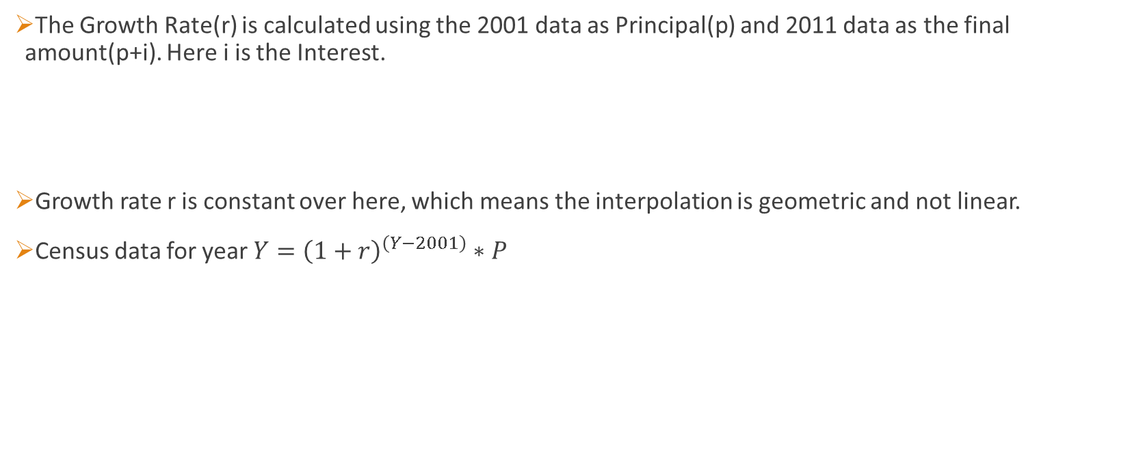
Generation of Census Data
The Growth Rate(r) is calculated using the 2001 data as Principal(p) and 2011 data as the final amount(p+i). Here i is the Interest.
Growth rate r is constant over here, which means the interpolation is geometric and not linear.
Census data for year $Y={\left(1+r\right)}^{\left(Y−2001\right)}∗P$

Slide 9
Feature Selection
HMIS
Out of 163 attributes we filtered out 42 attributes for our project
There are many attributes which represent the percentage of the other attributes, consequently, have been dropped due to multi collinearity
CENSUS
6 Attributes have been selected out of 64
Area name
Population
Literate persons
Main workers
Marginal workers
Non-workers

Slide 10
Data Integration
Merged HMIS and Census data. Both the datasets has one same attribute i.e., District Name
This attribute is ‘Area Name’ in Census data, and it is ‘Indicator’ in HMIS data
Performed natural join on this common attribute
Conflicts in district names are resolved using edit distance.

Slide 11
Data Exploration
Univariate Analysis
Independent and Dependent variable identification
Multivariate Analysis
Missing Value Treatment
Outlier Analysis

Slide 12
Univariate Analysis
Exploring variables/attributes one by one
Out of 47 attributes only one is categorical and all the others are numerical
Since we are solving regression problem, categorical data "Indicator" is of no use in our prediction. So, we removed it from the data set.

Slide 13
Independent and Dependent variable identification
Identify Predictor (Input) and Target (output) variables.
Case 1: Predicting number of Births in a year
Independent\Target attribute: ’Total Number of reported live births’
Dependent attributes: Rest 45 attributes of the dataset.
Case 2: Predicting number of Still-Births in a year
Independent\Target attribute: ’Total Number of reported Still Births’
Dependent attributes: Rest 45 attributes of the dataset.
Case 3: Predicting number of Infant-Deaths in a year
Independent\Target attribute: ’Total Number of reported Infant Deaths’
Dependent attributes: Rest 45 attributes of the dataset.

Slide 14
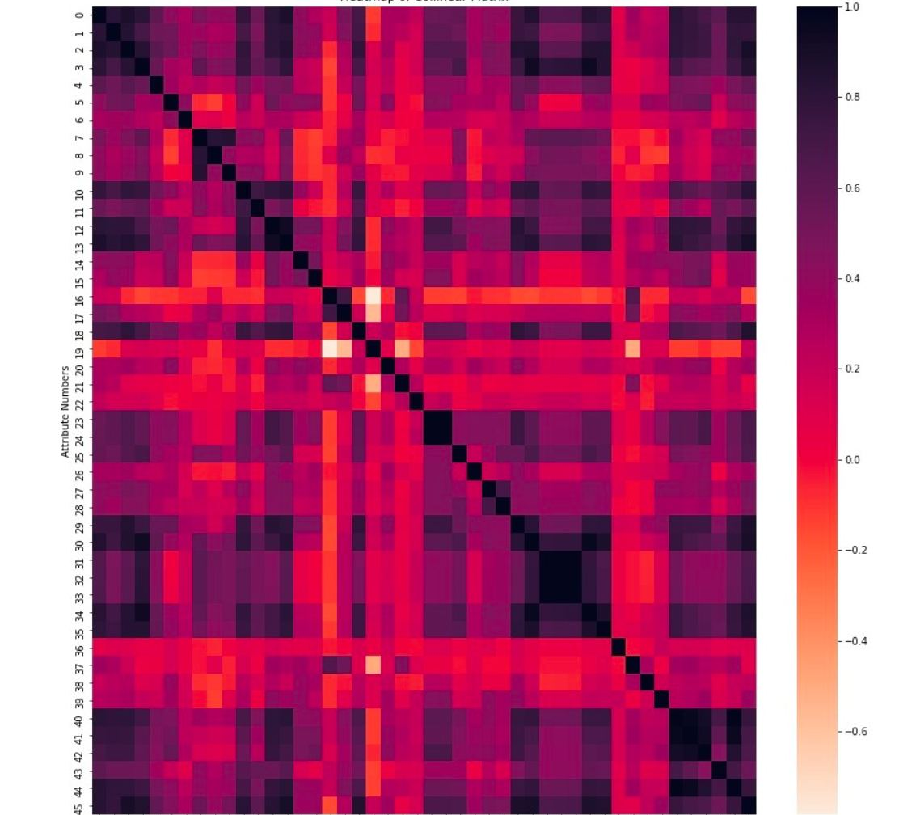
Multivariate Analysis
HeatMap of Collinear matrix of dataset
Dark squares in the HeatMap shows high correlation between the attributes

Slide 15

Missing Value Treatment
Most tricky part of this data exploration as there are no NaN values in our dataset at this stage.
All NaN values in Census data were taken care at the individual pre-processing of the census files
In HMIS data there are no NaN values but there are values which are equal to zero.
The tricky part is whether these zero values are missing values or actual value of the data example is zero.

Slide 16
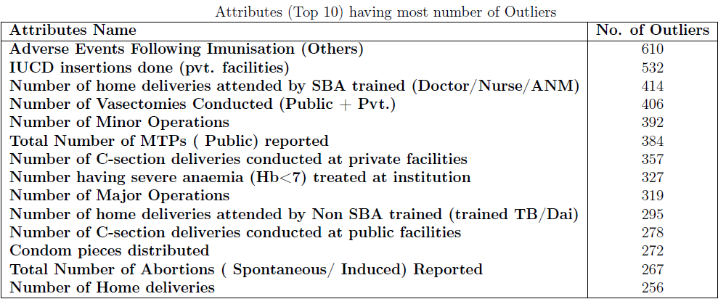
Outlier Analysis
IQR Test(Interquartile Range)
The data is sorted in ascending order and split into 4 equal parts
The data points which fall below Q1 – 1.5 IQR or above Q3 + 1.5 IQR are outliers
CS685A: Data Mining Project Report

Slide 17
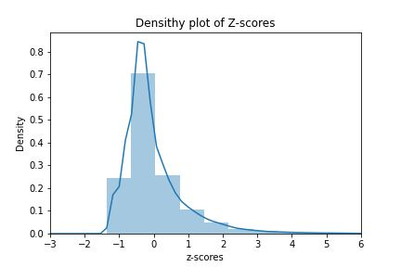
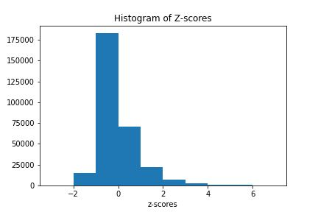
Outlier Analysis
Z-Score
Z score helps to understand if a data value is greater or smaller than mean and how far away it is from the mean
Z score tells how many standard deviations away a data point is from the mean
If the z score of a data point is more than 3, it indicates that the data point is quite different from the other data points

Slide 18
Prediction
Measure | Linear Regression | Random Forest
Training Mean Absolute Error | 2828.6132176902 | 574.652419301165
Test Mean Absolute Error | 5109.2537316244 | 2229.61431932773
Training Root Mean Square Error | 5362.25745574993 | 1564.56984390149
Testing Root Mean Square Error | 8402.35904407914 | 5916.33023171844
Training Accuracy(R-square) | 95.7276759961367 | 99.6362870467858
Testing Accuracy(R-square) | 93.3642138572999 | 96.7100088929496
CASE 1: PREDICTION OF NUMBER OF BIRTHS

Slide 19
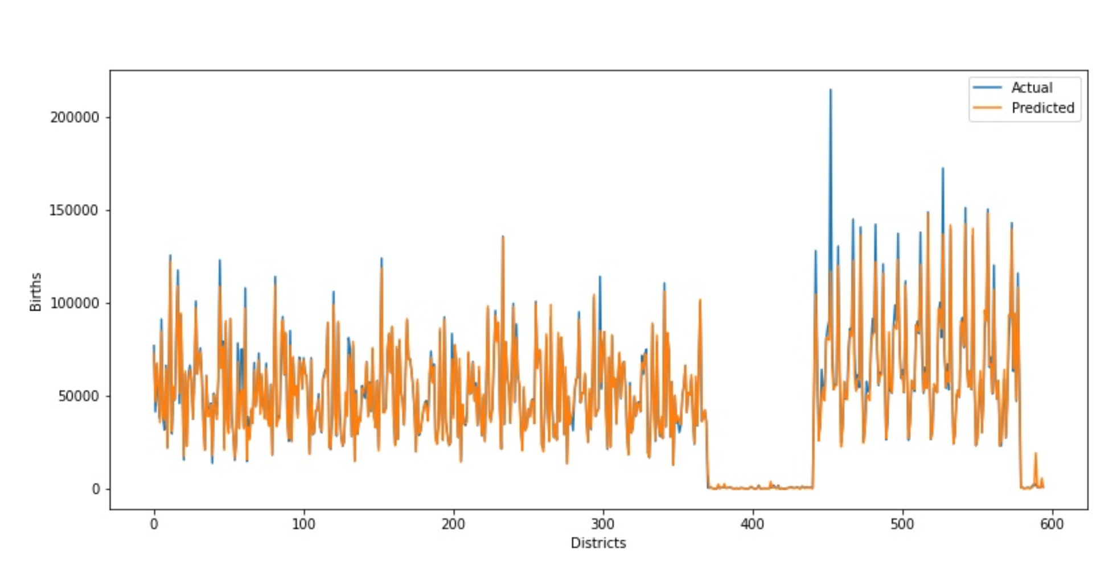
Prediction
CASE 1: PREDICTION OF NUMBER OF BIRTHS
Random forest result for births(Actual vs Predicted)

Slide 20
Prediction
Measure | Linear Regression | Random Forest
Training Mean Absolute Error | 1023.99261949344 | 89.88106998654105
Test Mean Absolute Error | 2390.04152966319 | 541.9993948562783
Training Root Mean Square Error | 2235.31247540752 | 396.0021534095236
Testing Root Mean Square Error | 4821.80489352115 | 2139.573840681855
Training Accuracy(R-square) | 88.124395801068 | 99.62728718459579
Testing Accuracy(R-square) | 92.4555099954537 | 98.51452557349563
CASE 2: PREDICTION OF NUMBER OF STILL-BIRTHS

Slide 21
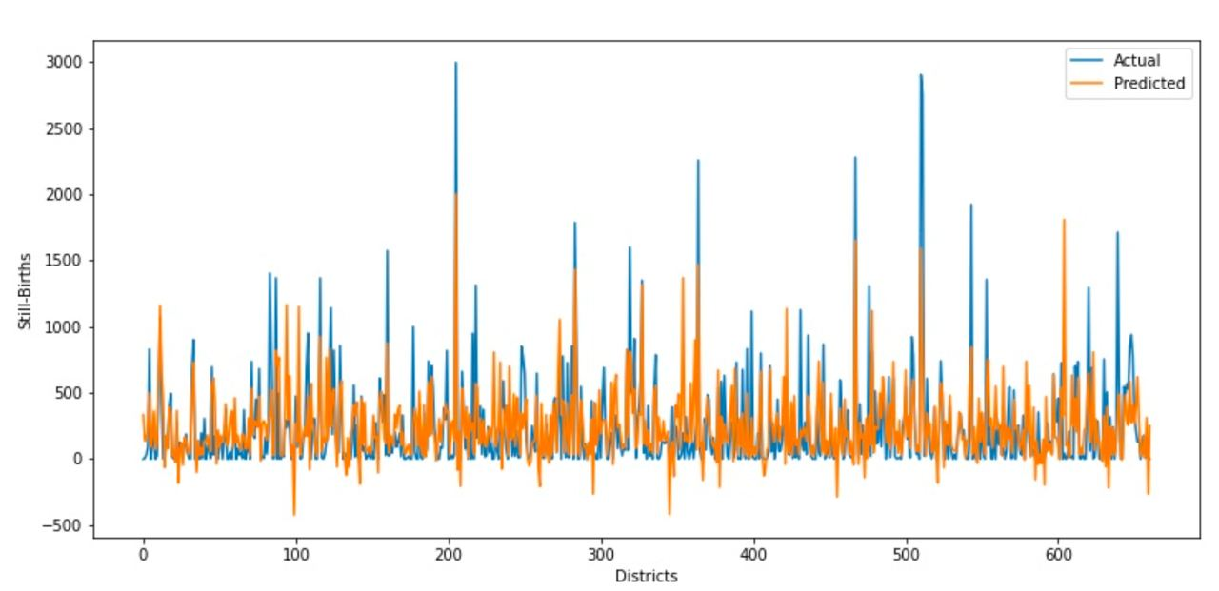
Prediction
CASE 2: PREDICTION OF NUMBER OF STILL-BIRTHS
Random forest result for still births(Actual vs Predicted)

Slide 22
Prediction
Measure | Linear Regression | Random Forest
Training Mean Absolute Error | 176.98444922111506 | 44.47679676985195
Test Mean Absolute Error | 171.44992601028855 | 113.2001815431165
Training Root Mean Square Error | 284.300609512833 | 87.23965230976026
Testing Root Mean Square Error | 265.06288848278155 | 201.14927401387413
Training Accuracy(R-square) | 48.09697806858291 | 95.12455070018713
Testing Accuracy(R-square) | 49.51743097935387 | 70.56988968985102
CASE 3: PREDICTION OF NUMBER OF INFANT DEATHS

Slide 23
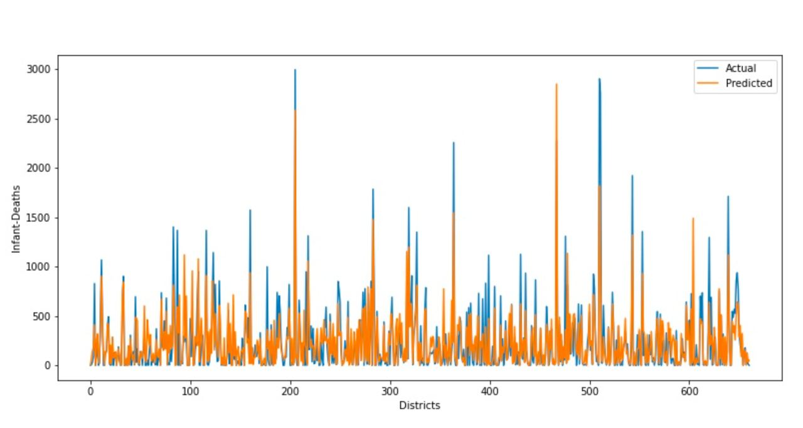
Prediction
CASE 3: PREDICTION OF NUMBER OF INFANT DEATHS
Random forest result for still infant deaths(Actual vs Predicted)

Slide 24
Results
Model Name | Problem Statement | Training Accuracy | Testing Accuracy
Linear Regression | Child Births | 0.957267 | 0.933956
Random Forest | Child Births | 0.993489 | 0.960923
Linear Regression | Still Births | 0.881243 | 0.924555
Random Forest | Still Births | 0.996272 | 0.985145
Linear Regression | Infant Deaths | 0.480969 | 0.495174
Random Forest | Infant Deaths | 0.9512345 | 0.705698

Slide 25
Discussions
For the prediction of total number of births, ‘Total number of pregnant women Registered for ANC’, ‘Number of pregnant women received 3 ANC check ups’, ‘Deliveries Conducted at Public Institutions’ have come out as the most influential factors.
For the prediction of total number of still births, ‘Total reported deliveries’, ‘TT2 or Booster given to Pregnant women’, ‘Number of Minor Operations’ have come out as the most influential factors.
For the prediction of total number of infant deaths, ‘Number of Major Operations’, ‘Number of C-section deliveries conducted at public facilities’, ‘Number of home deliveries attended by Non-SBA trained’ have come out as the most influential factors.

Slide 26
Discussions
Used Linear regression and Random Forest regression for prediction
Random Forest Regressor Model performs the best with training accuracy of 99.15% and testing accuracy of 94.41%
Decision Trees are great for obtaining non-linear relationships between input features and the target variable
Random forest is an ensemble of decision trees. This is to say that many trees, constructed in a certain “random” way form a Random Forest
The averaging makes a Random Forest better than a single Decision Tree hence improves its accuracy and reduces overfitting
A prediction from the Random Forest Regressor is an average of the predictions produced by the trees in the forest

Slide 27
THANK YOU

